Slide 1
Application Server & Frontend

Slide 2

Current Setup
Local
Machine
LLMProxy
Request/Response

Slide 3
Future Setup
Messaging
Server
Chatbot
Application
LLMProxy
Request/Response
Request/Response
Request/Response
Multiple Users.
Availability.
Testing flexibility.
Messaging
Client

Slide 4
Application Server - Koyeb

Slide 5
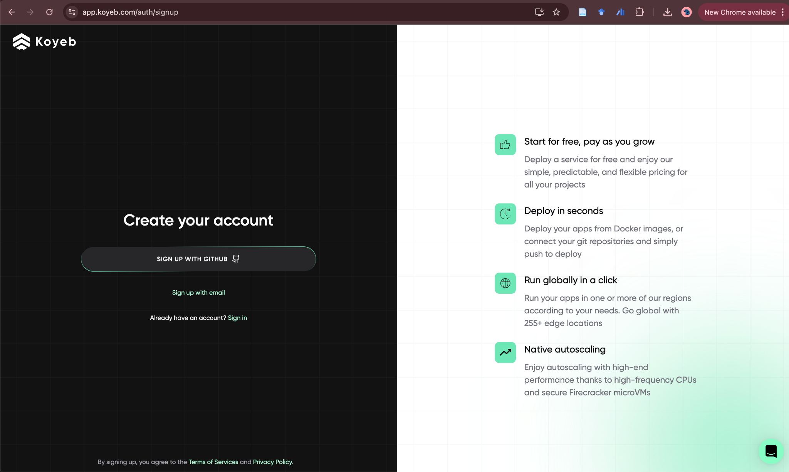
Chatbot Application - Koyeb
Free tier:
Serverless Compute
vCPU - 0.1
RAM - 512MB
Disk - 2GB
Sign-up using email
Automatic update from Github
(optionally docker image)
No credit card required
https://app.koyeb.com/auth/signup

Slide 6
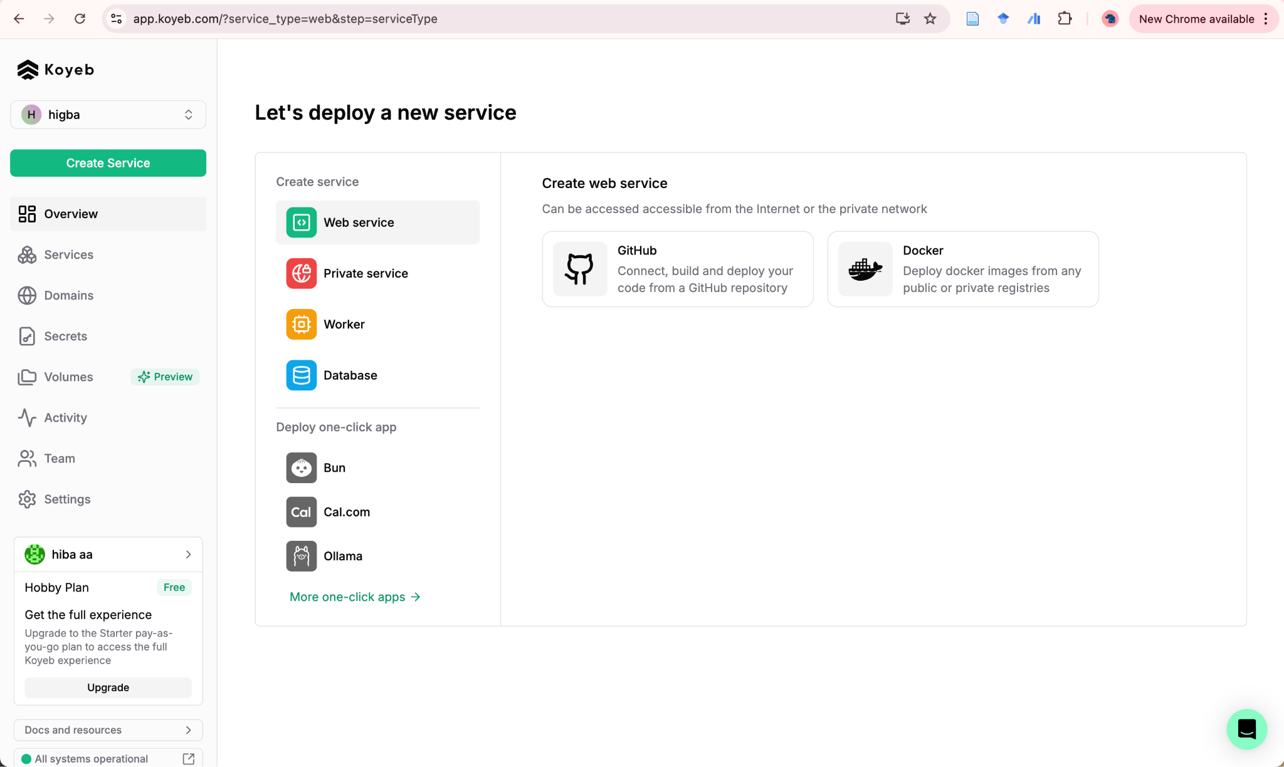
Chatbot Application - Koyeb

Slide 7
Chatbot Application - Koyeb
Make sure your github repo has:
requirements.txt → updated list of required pkgs
Procfile → command to start the service
Remove config.json —> use environment variables (updated LLMProxy file)
A sample will be added to the class repo.

Slide 8
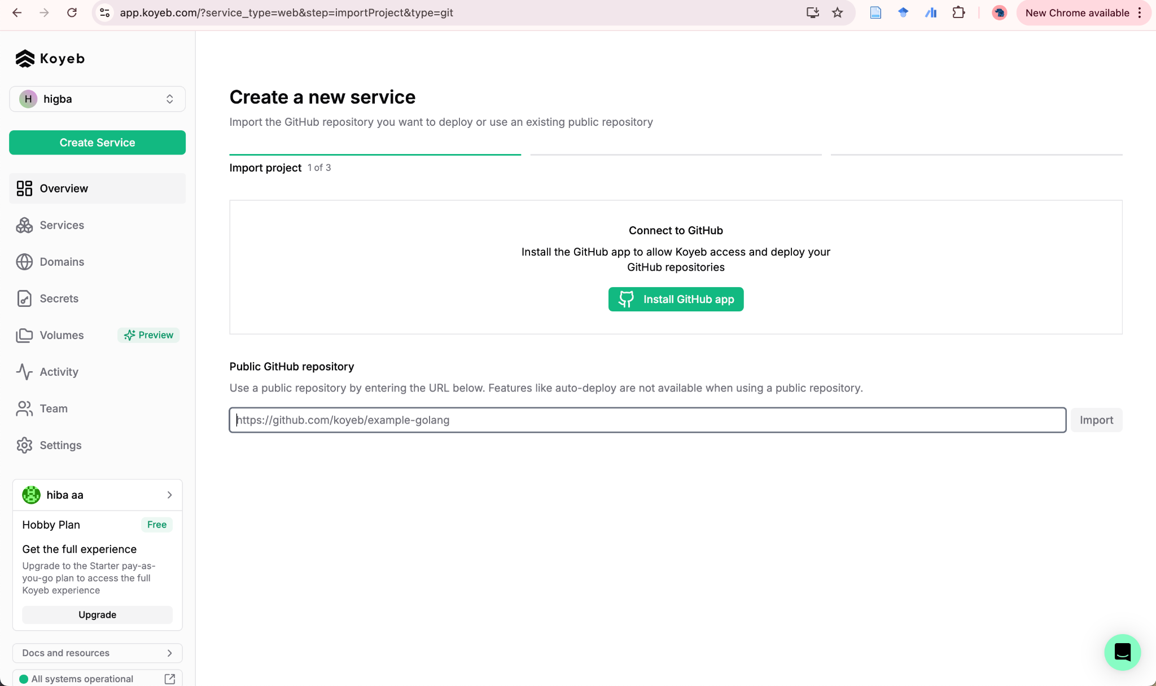
Chatbot Application - Koyeb

Slide 9
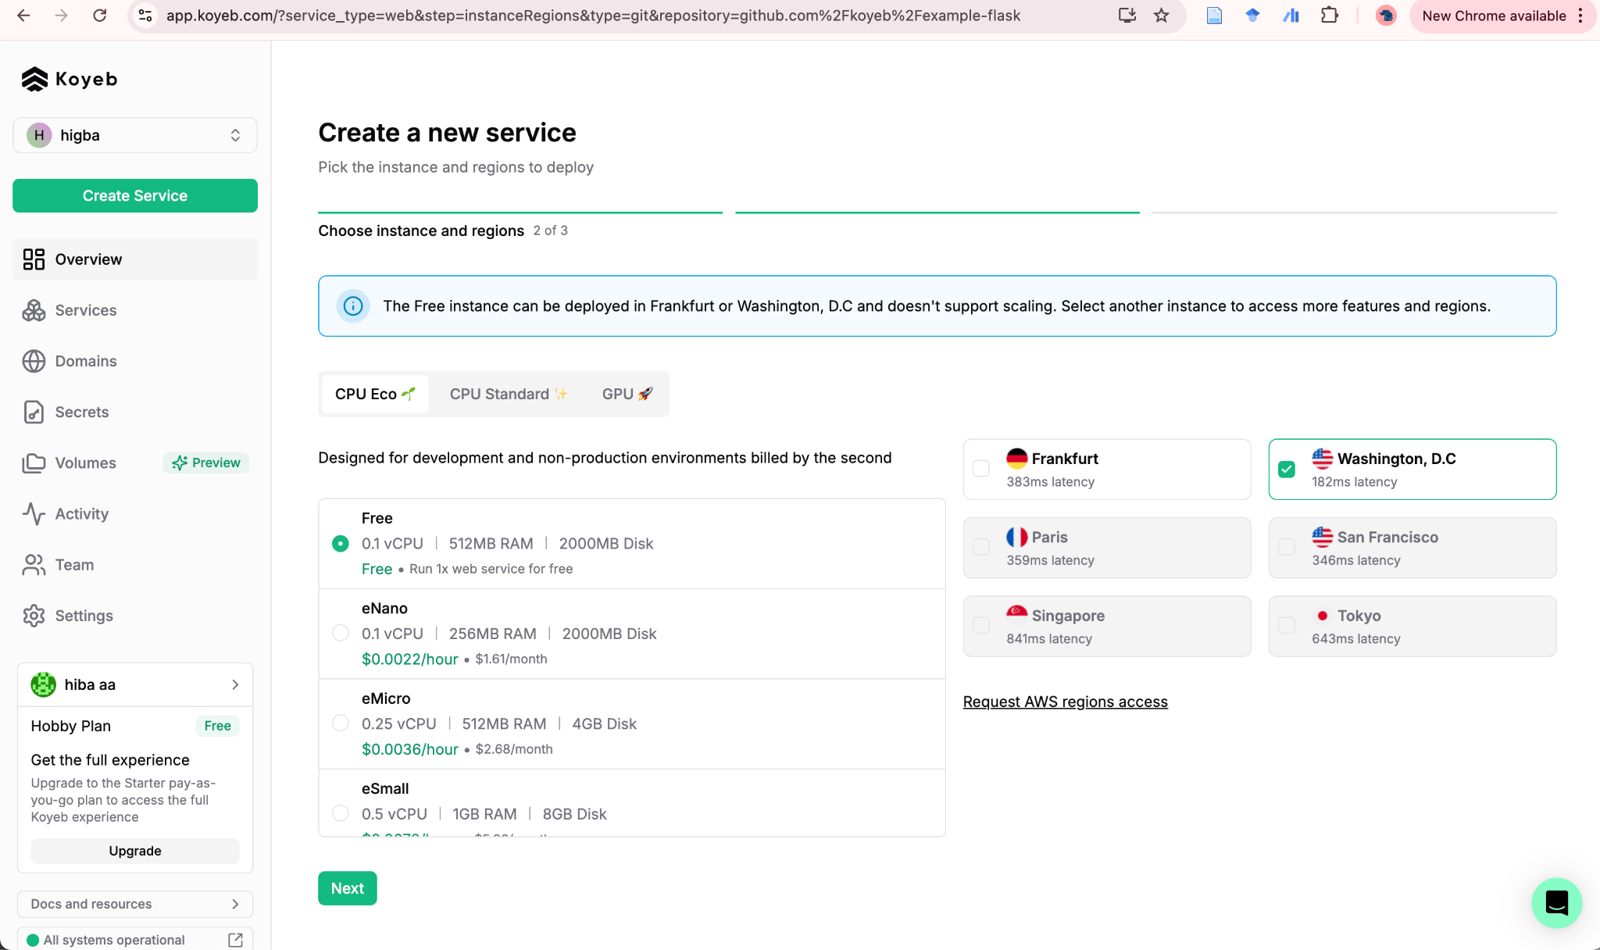
Chatbot Application - Koyeb

Slide 10
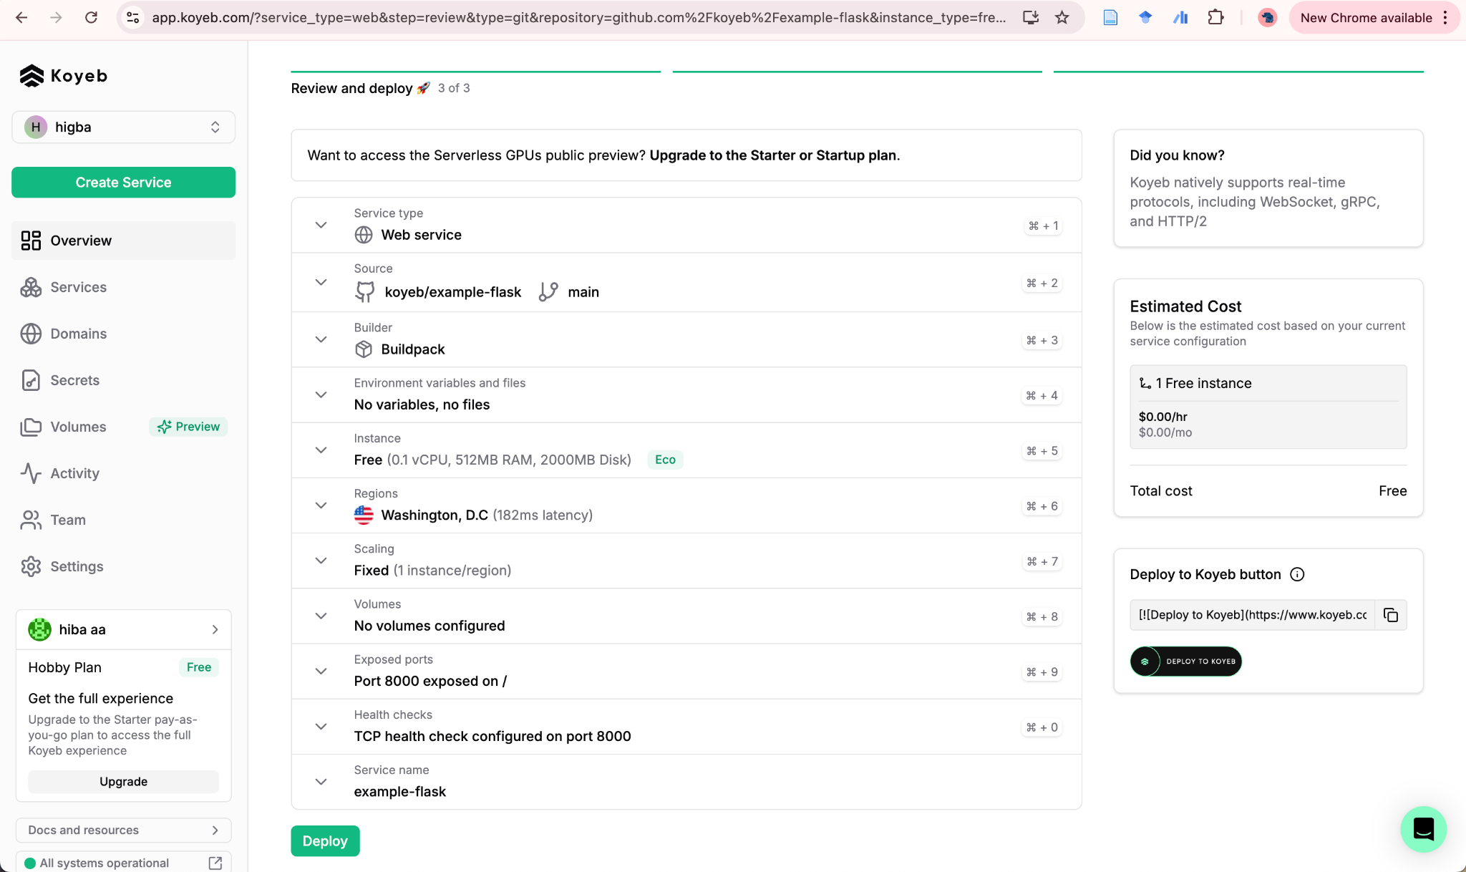
Chatbot Application - Koyeb

Slide 11
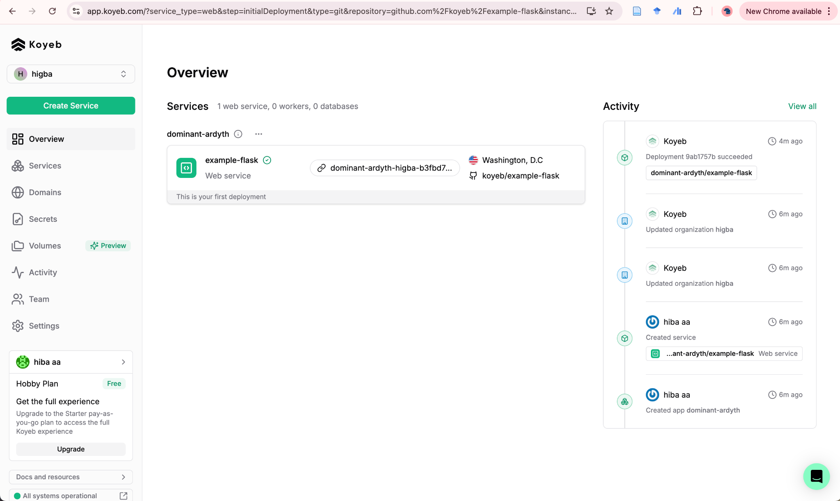
Chatbot Application - Koyeb

Slide 12
Chatbot Application - Koyeb
Once deployed - a unique link for the service is generated
Can be used for testing and integration.
Use secrets manager to add LLMProxy authentication info https://app.koyeb.com/secrets

Slide 13
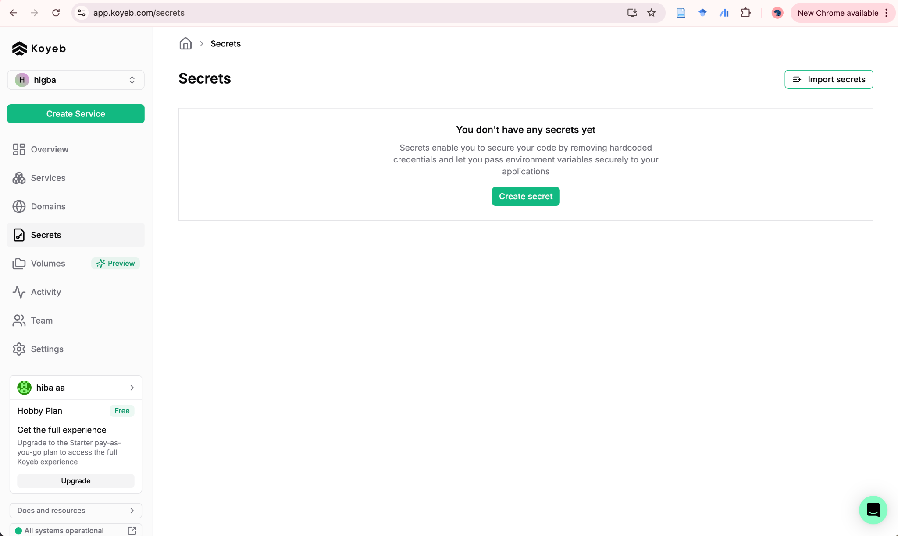
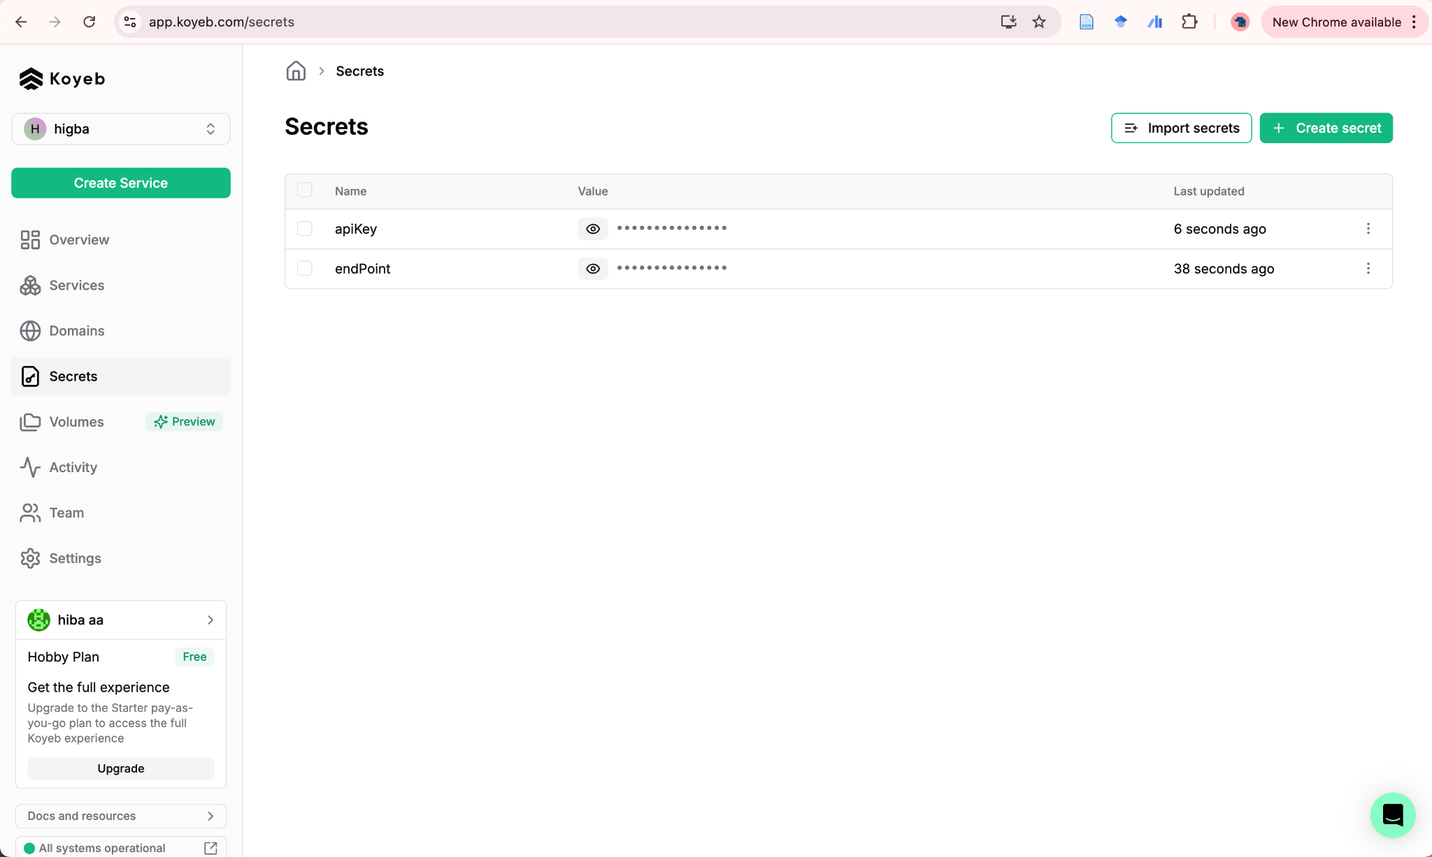
Koyeb - Secrets

Slide 14
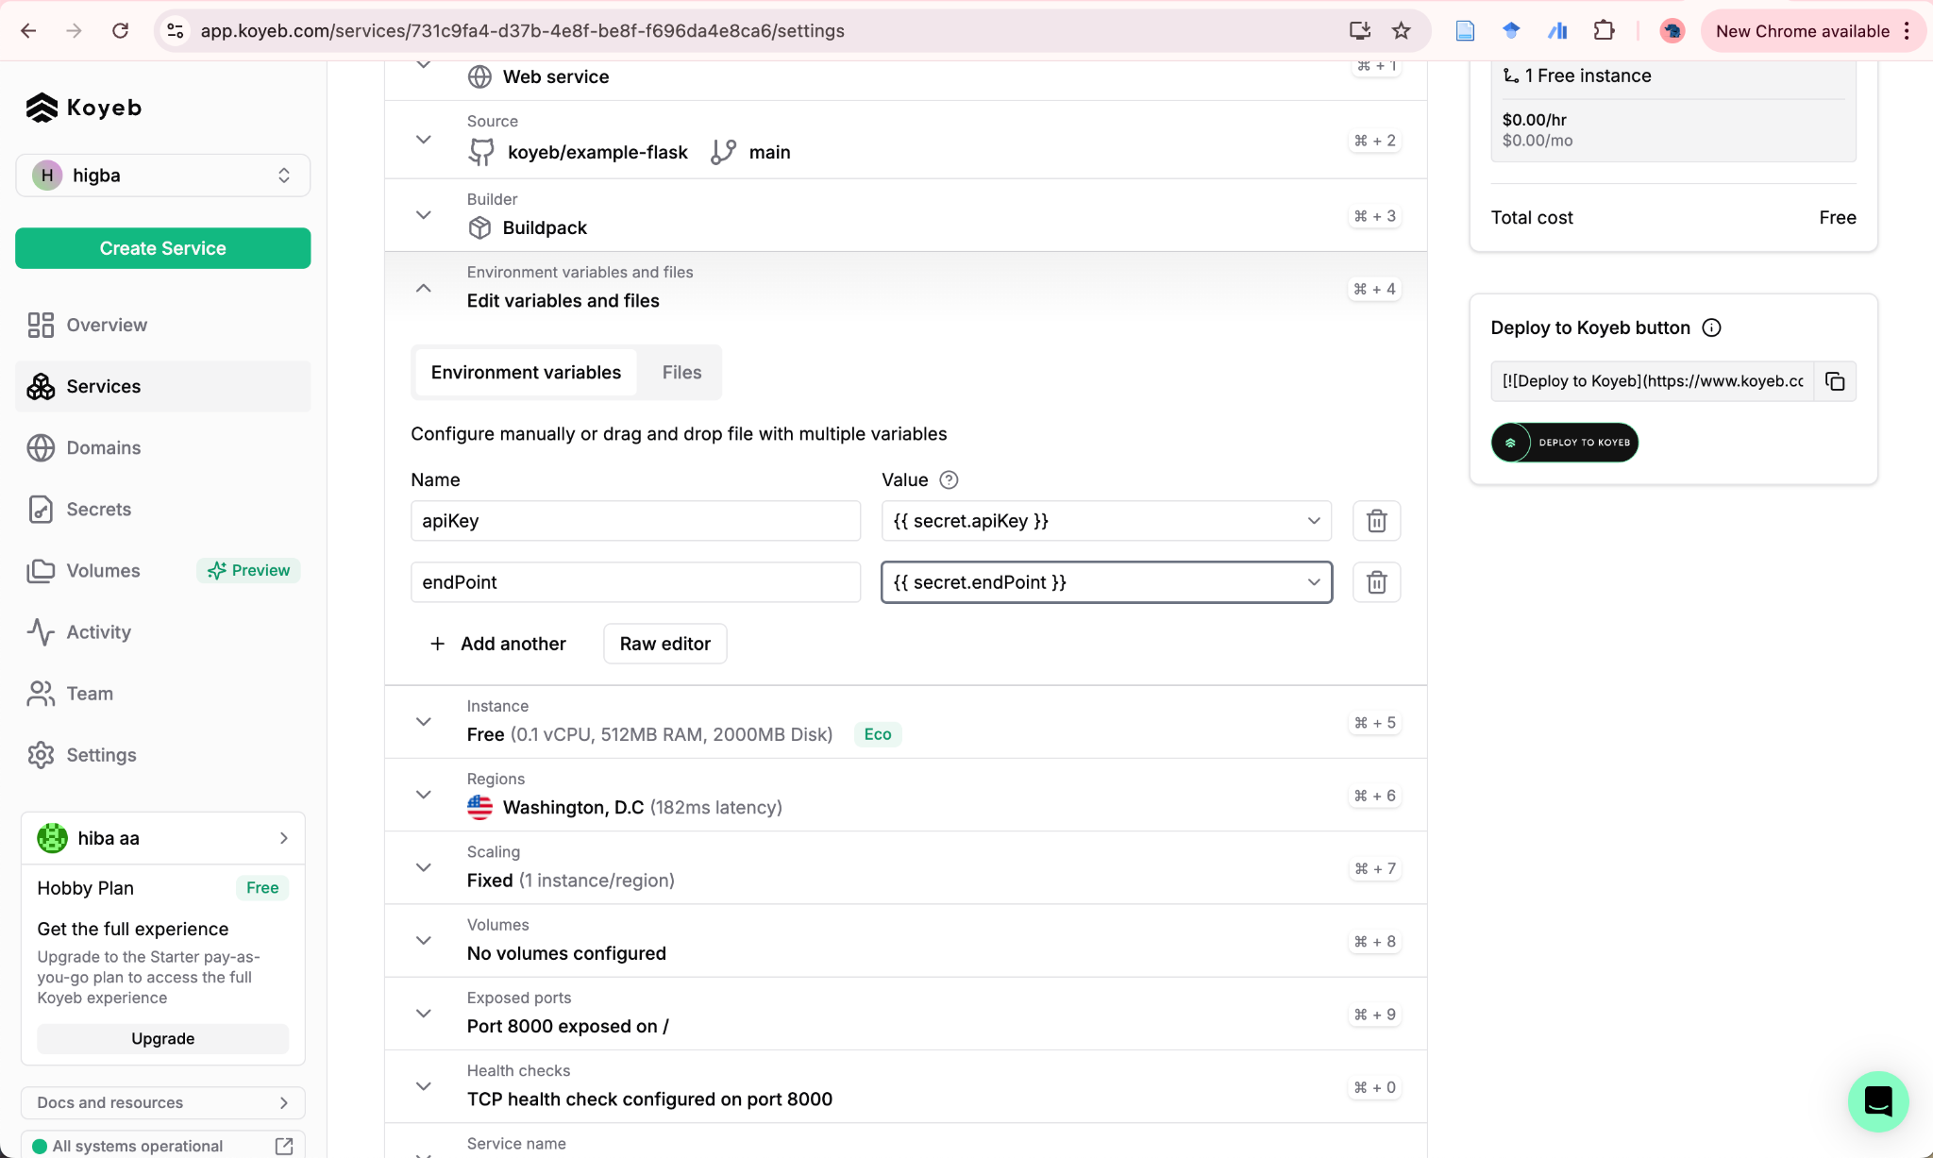
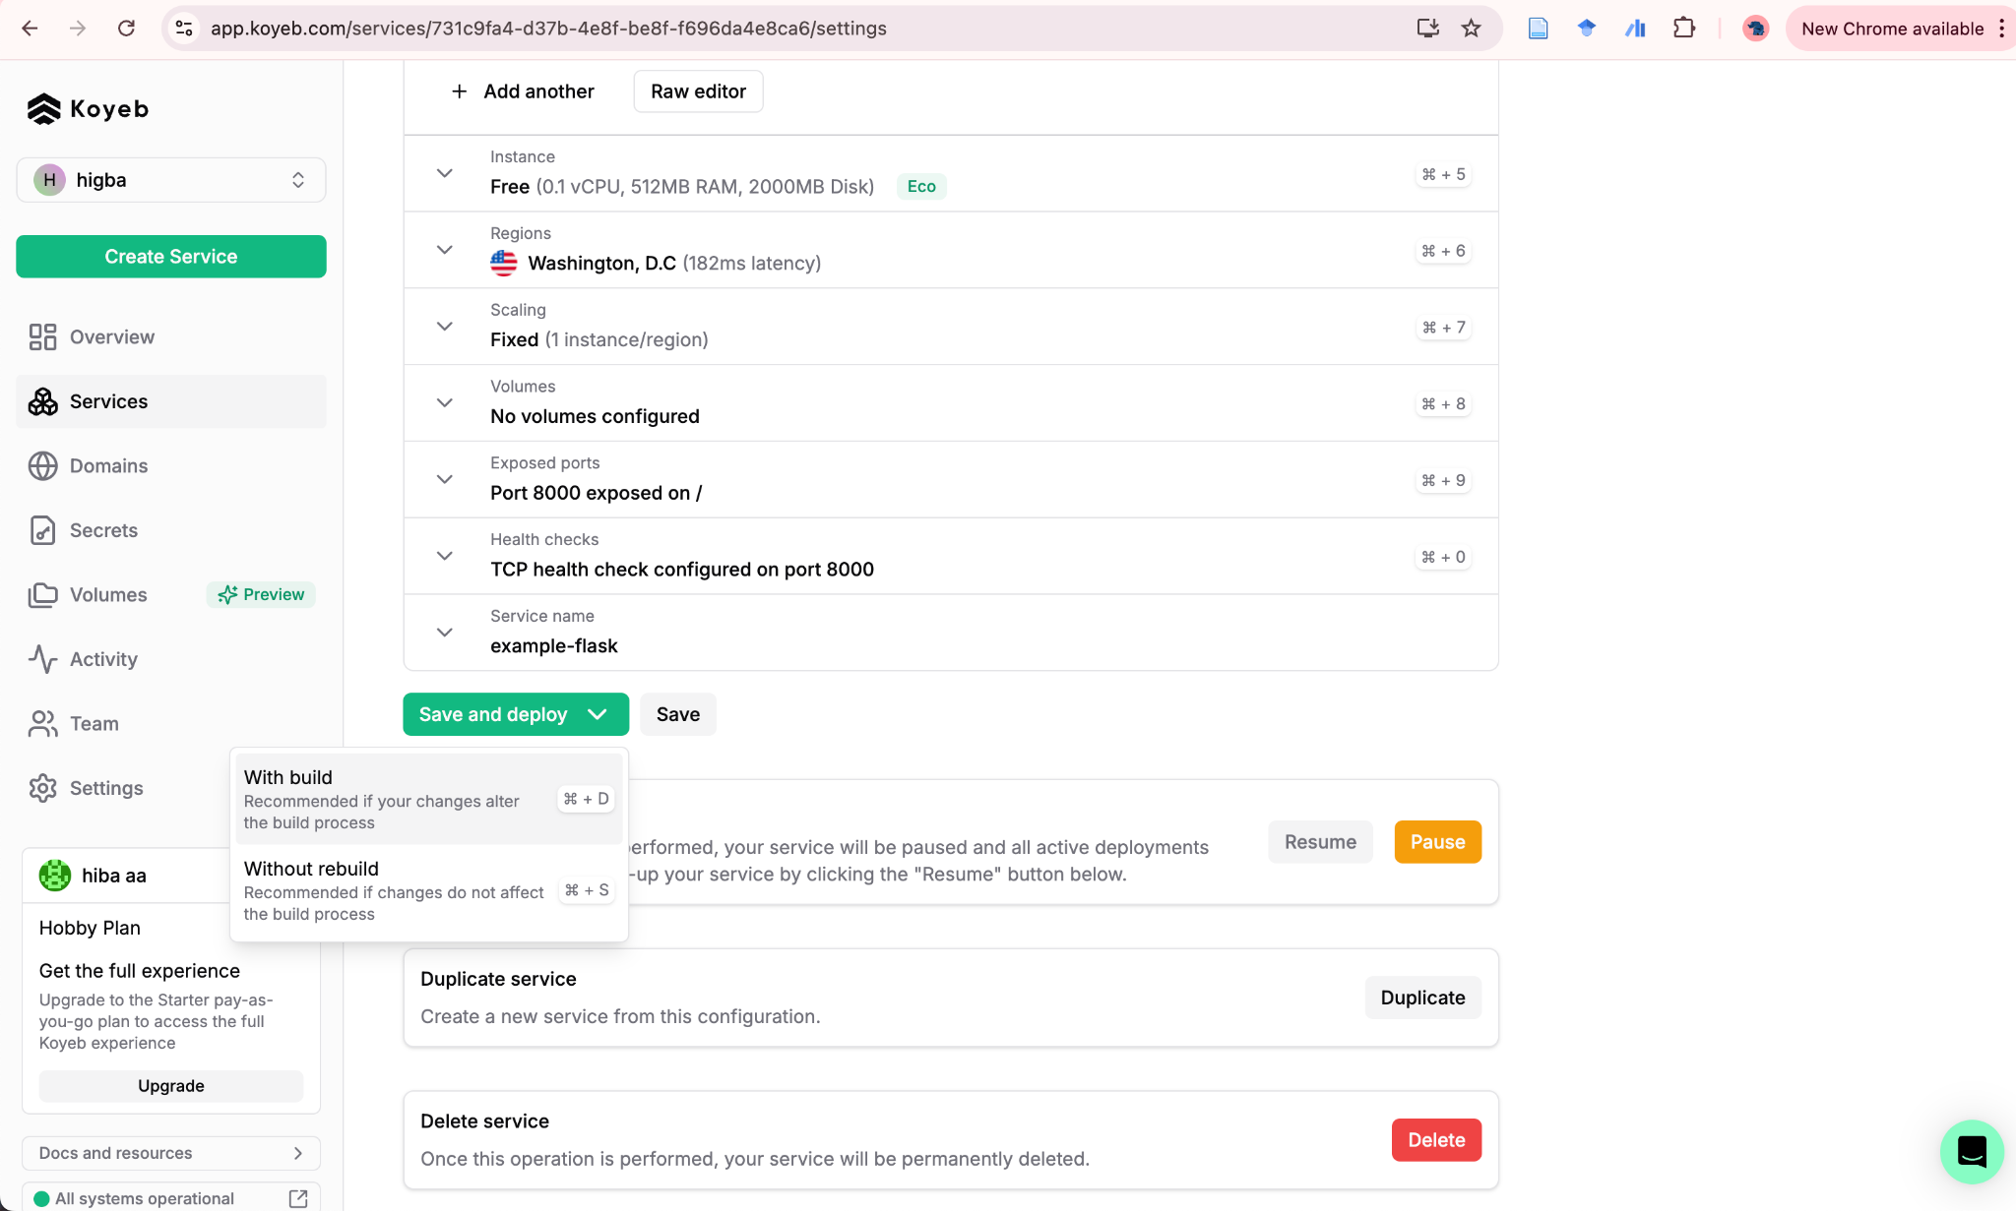
Koyeb - Secrets
Home -> web service -> settings -> environment variables

Slide 15
Application Server is UP
Service will be automatically re-deployed with each "push" to github
Logs for the last 1hour available: Home → Web Service → Overview → Deployment
Make redeploy with build if changes don't take effect.

Slide 16
Front End - Rocket Chat

Slide 17
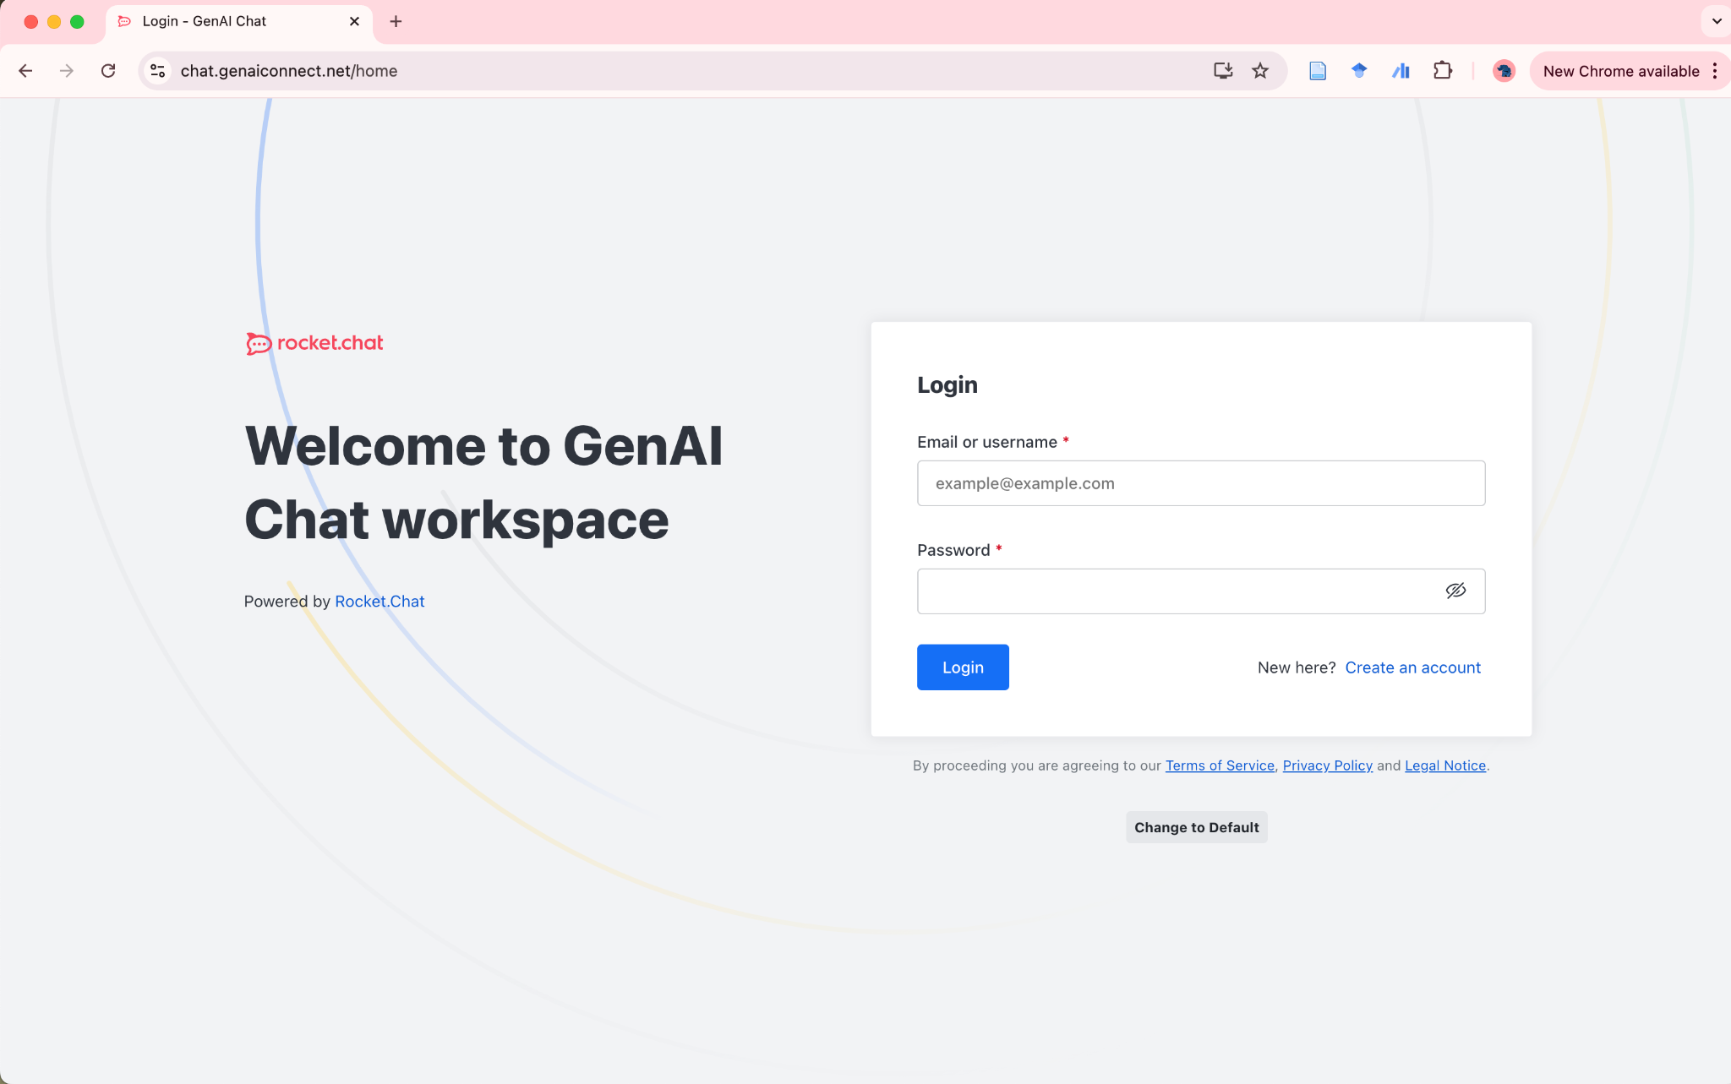
RocketChat - initial login
Login page - https://chat.genaiconnect.net/home
You will receive your login details in the email.
This is your personal account - remember to change your password after logging in.
Reply to the email with:
Your Koyeb application link

Slide 18
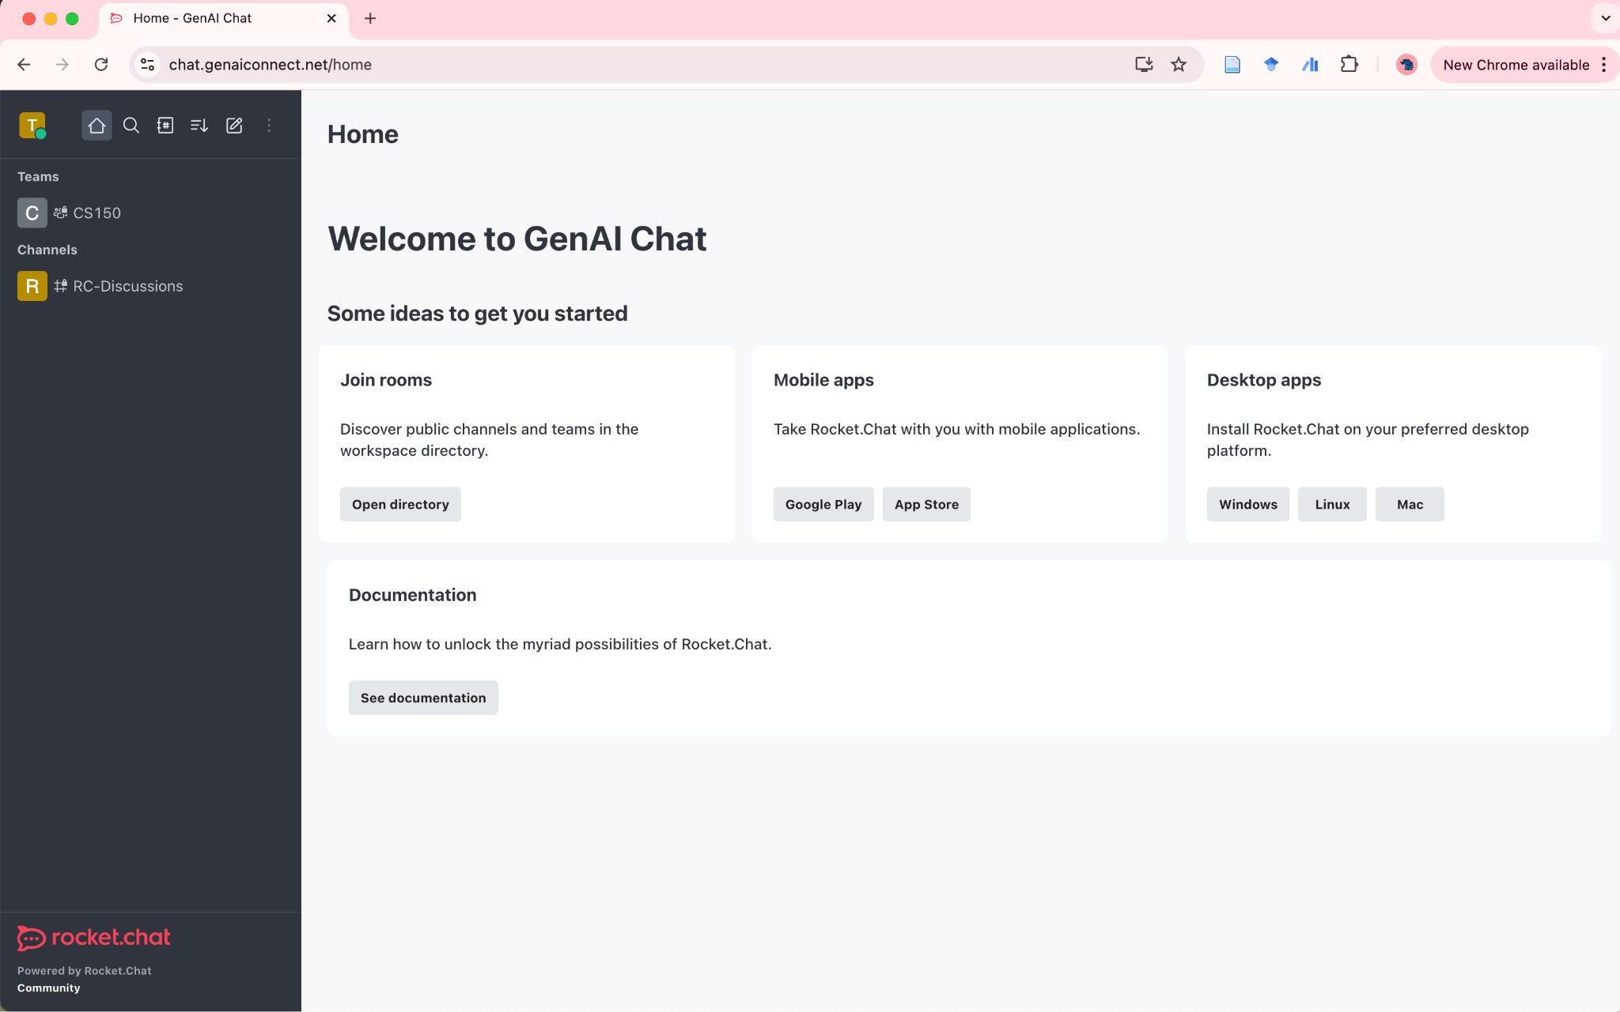
RocketChat - CS150
CS150 team space and default channel on the left panel

Slide 19
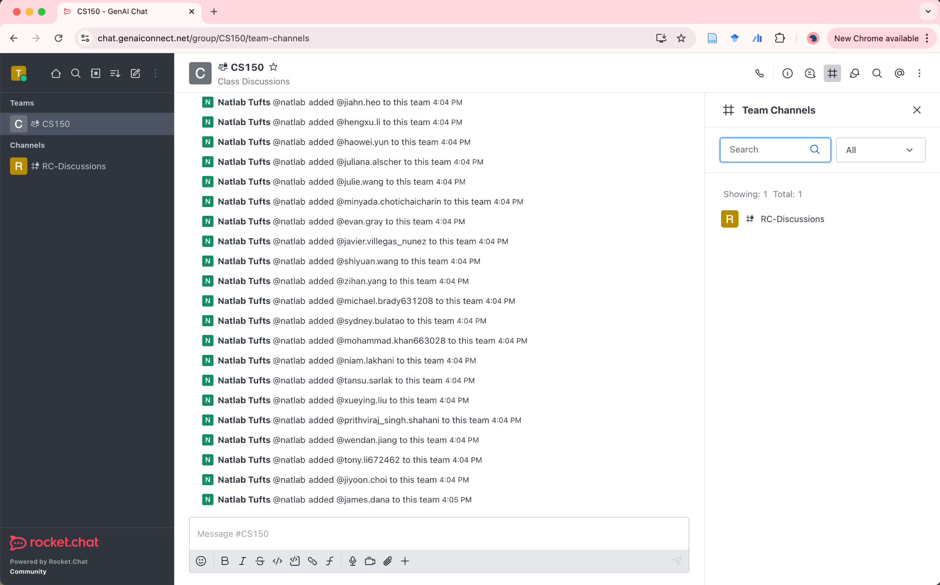
RocketChat - CS150
Use the upper right menu to navigate team channels and see members.

Slide 20

RocketChat - find team members
Find other team members and bots to start conversation.

Slide 21
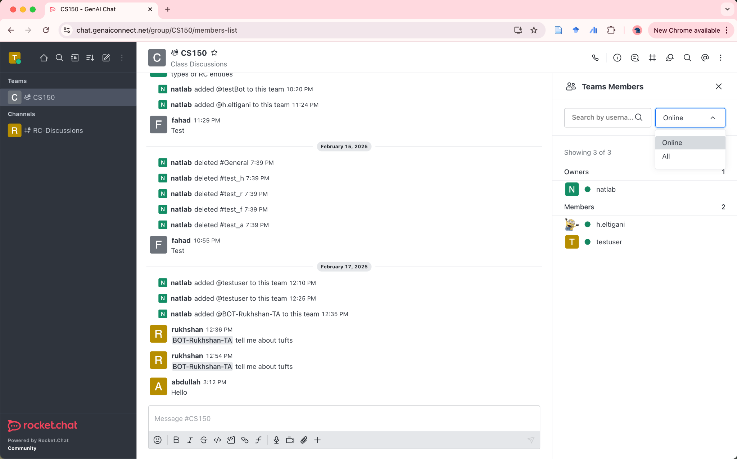
RocketChat - see all team members

Slide 22
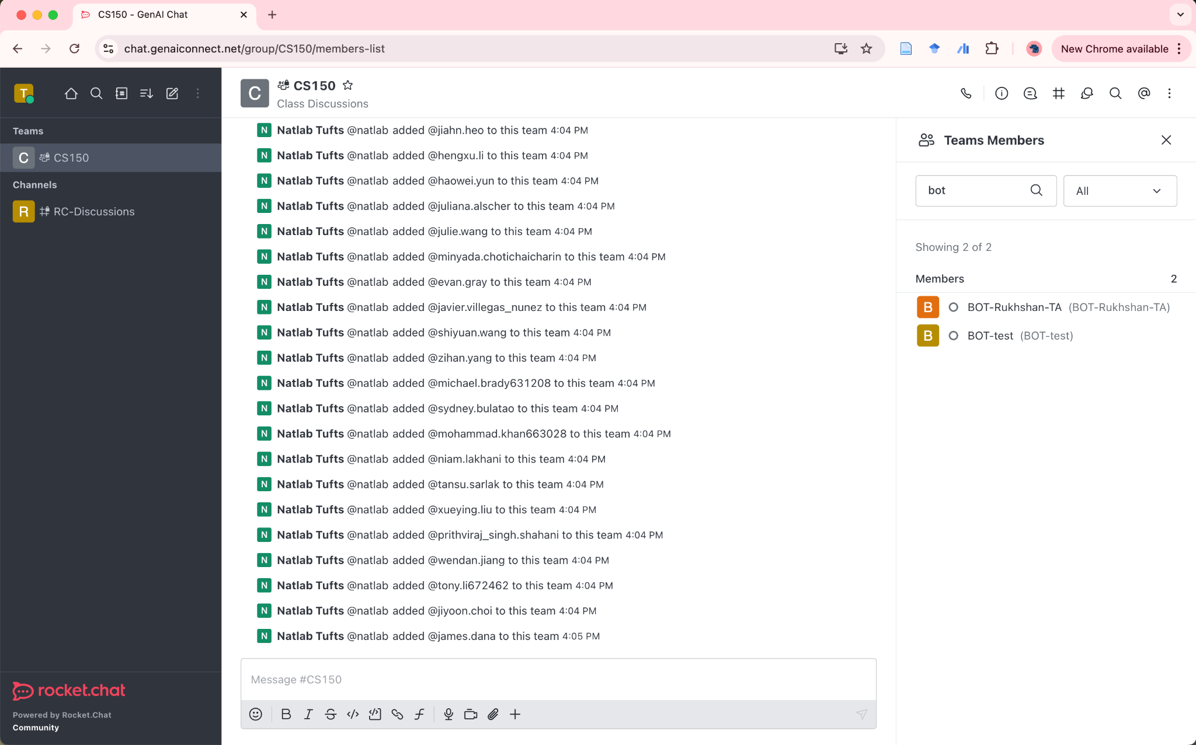
RocketChat - test students bots
Bots will be members of the team that start with the prefix "BOT-xxxx"
They will be added gradually. Currently, you can test with "BOT-test".
Communication with bots can only be through direct messages.

Slide 23
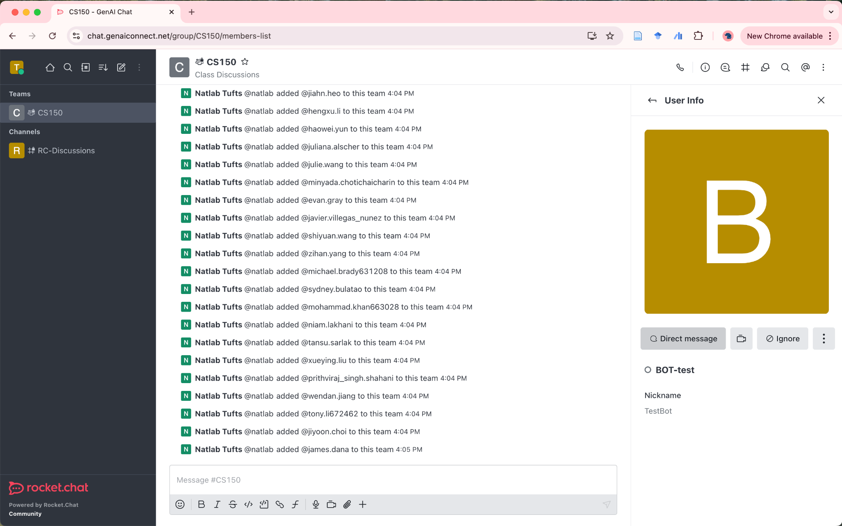
RocketChat - select a bot and send a direct message

Slide 24
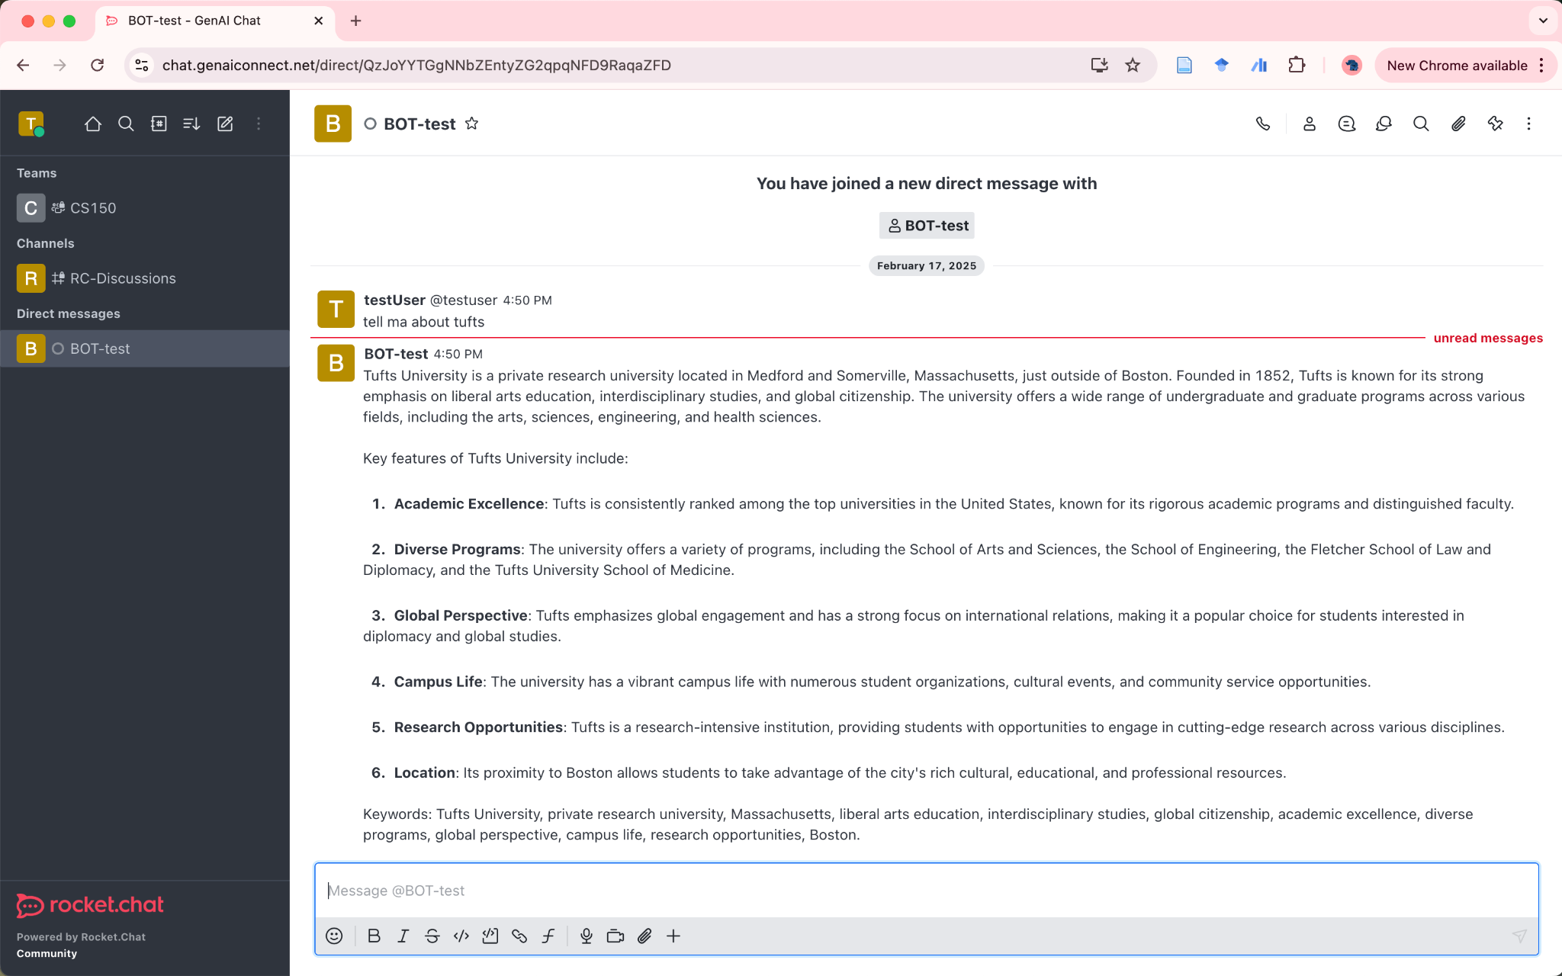
RocketChat - engage in a conversation with the bot

